Slide 1

HTML DOM (Document Object Model)
When a web page is loaded, the browser creates a Document Object Model of the page.
The HTML DOM model is constructed as a tree of Objects:

Slide 2
Javascript and DOM
With the object model, JavaScript gets all the power it needs to create dynamic HTML:
JavaScript can change all the HTML elements in the page
JavaScript can change all the HTML attributes in the page
JavaScript can change all the CSS styles in the page
JavaScript can remove existing HTML elements and attributes
JavaScript can add new HTML elements and attributes
JavaScript can react to all existing HTML events in the page
JavaScript can create new HTML events in the page

Slide 3
What you will learn?
How to change the content of HTML elements
How to change the style (CSS) of HTML elements
How to react to HTML DOM events
How to add and delete HTML elements

Slide 4
What is the DOM
The DOM is a W3C (World Wide Web Consortium) standard.
The DOM defines a standard for accessing documents:
"The W3C Document Object Model (DOM) is a platform and language-neutral interface that allows programs and scripts to dynamically access and update the content, structure, and style of a document."
The W3C DOM standard is separated into 3 different parts:
Core DOM - standard model for all document types
XML DOM - standard model for XML documents
HTML DOM - standard model for HTML documents

Slide 5
What is the HTML DOM?
The HTML DOM is a standard object model and programming interface for HTML. It defines:
The HTML elements as objects
The properties of all HTML elements
The methods to access all HTML elements
The events for all HTML elements
The HTML DOM is a standard for how to get, change, add, or delete HTML elements.

Slide 6
HTML DOM Methods
The DOM Programming Interface
The HTML DOM can be accessed with JavaScript (and with other programming languages).
In the DOM, all HTML elements are defined as objects.
The programming interface is the properties and methods of each object.
A property is a value that you can get or set (like changing the content of an HTML element).
A method is an action you can do (like add or deleting an HTML element).

Slide 7
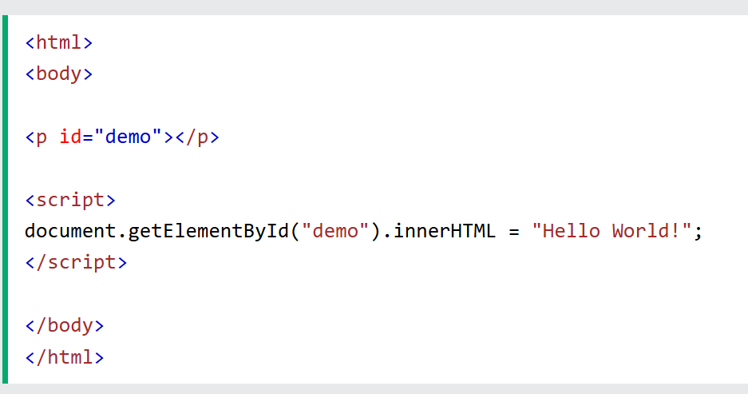
Example
Method
Property

Slide 8
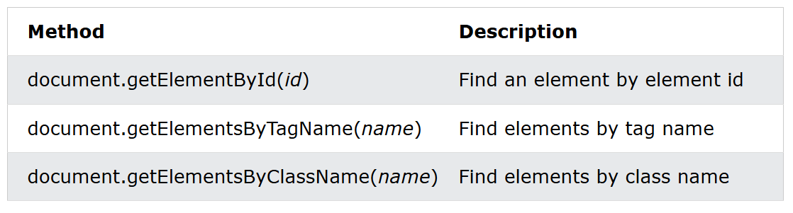
DOM Document
The document object represents your web page.
If you want to access any element in an HTML page, you always start with accessing the document object.
Finding HTML Elements

Slide 9
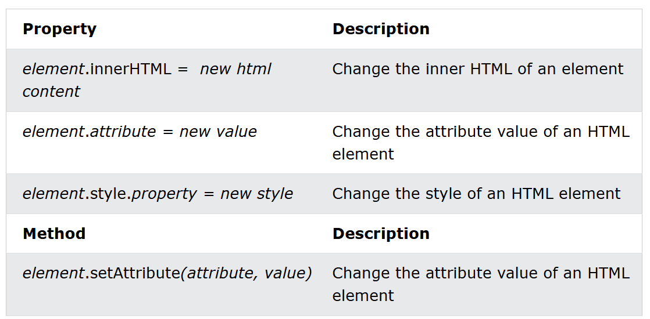
DOM Document
Changing HTML Elements

Slide 10
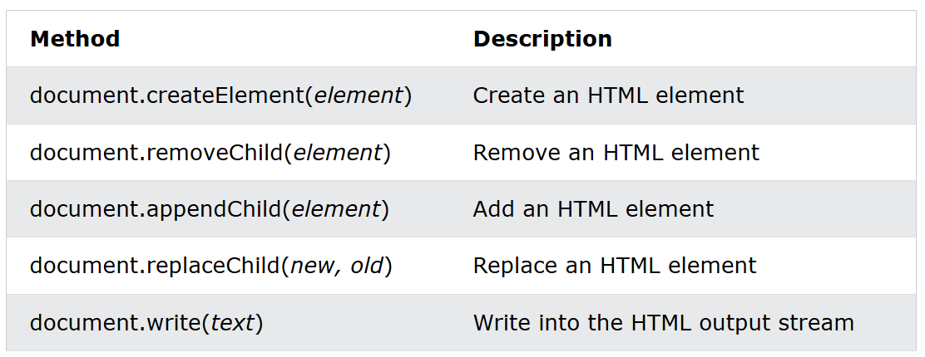
DOM Document
Adding and Deleting Elements

Slide 11
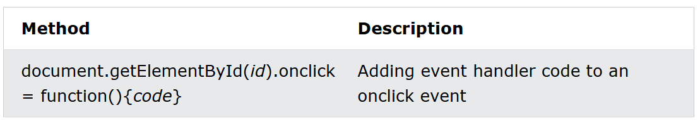
DOM Document
Adding Events Handlers

Slide 12
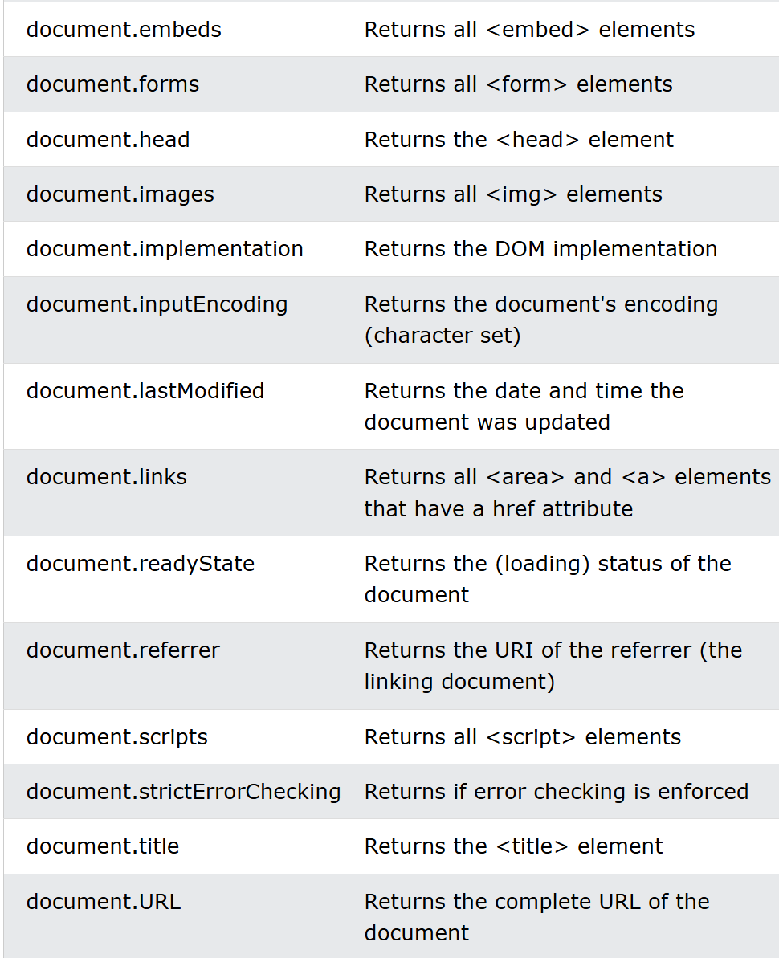
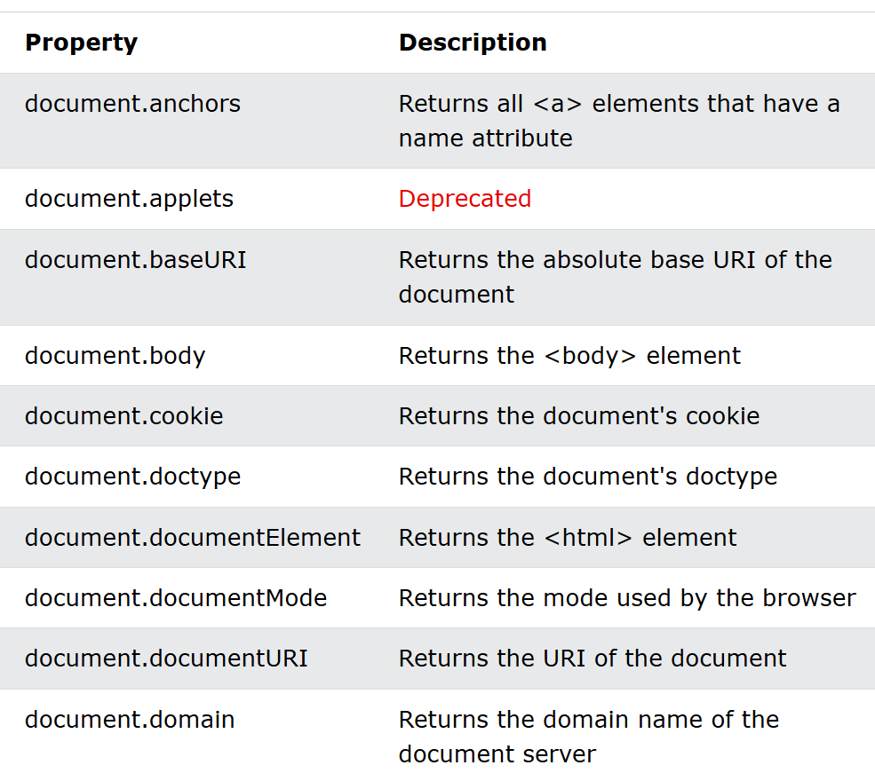
DOM Document
Finding HTML Objects

Slide 13


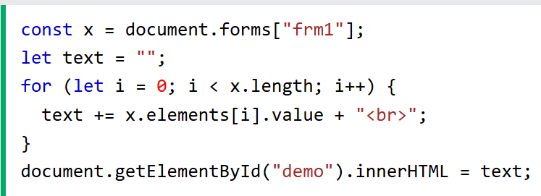
DOM Elements
Finding HTML Elements
Finding HTML elements by id
Finding HTML elements by tag name
Finding HTML elements by class name
Finding HTML elements by CSS selectors
Finding HTML elements by HTML object collections

Slide 14

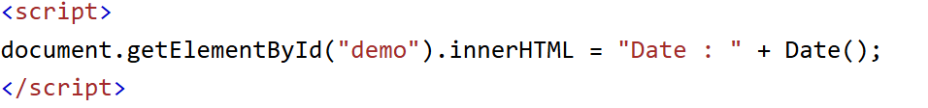
DOM HTML
Changing HTML Content
Changing the Value of an Attribute
Dynamic HTML content
document.write()

Slide 15
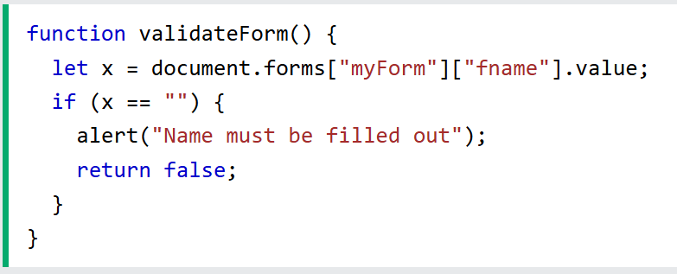
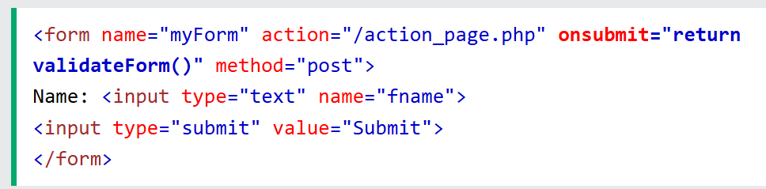
DOM Forms
JavaScript Form Validation
HTML form validation can be done by JavaScript.
If a form field (fname) is empty, this function alerts a message, and returns false, to prevent the form from being submitted:

Slide 16
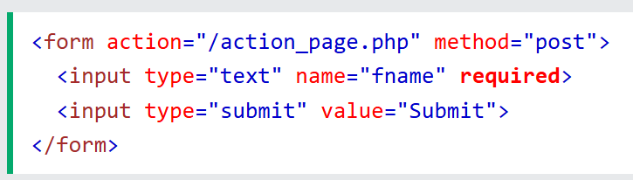
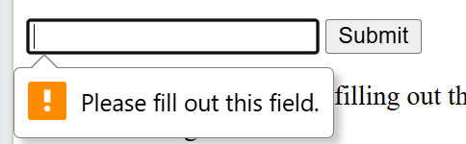
DOM Forms
HTML form validation can be performed automatically by the browser:
If a form field (fname) is empty, the required attribute prevents this form from being submitted:

Slide 17
DOM Form
Data validation is the process of ensuring that user input is clean, correct, and useful.
Typical validation tasks are:
has the user filled in all required fields?
has the user entered a valid date?
has the user entered text in a numeric field?
Most often, the purpose of data validation is to ensure correct user input.
Server side validation is performed by a web server, after input has been sent to the server.
Client side validation is performed by a web browser, before input is sent to a web server.

Slide 18
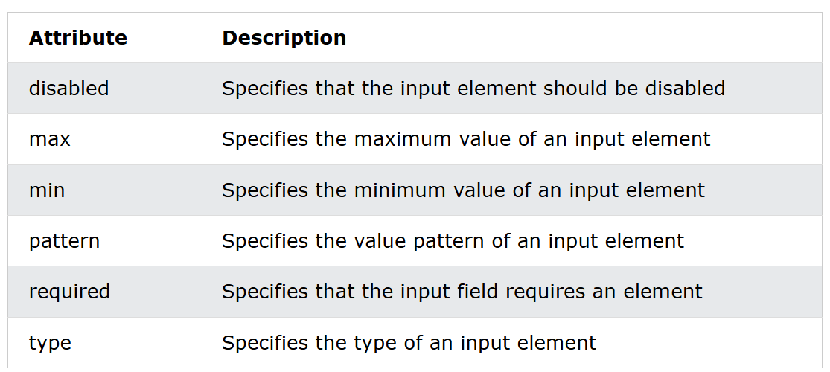
DOM Forms
Constraint Validation HTML Input Attributes

Slide 19

DOM CSS
Changing HTML Style

Slide 20
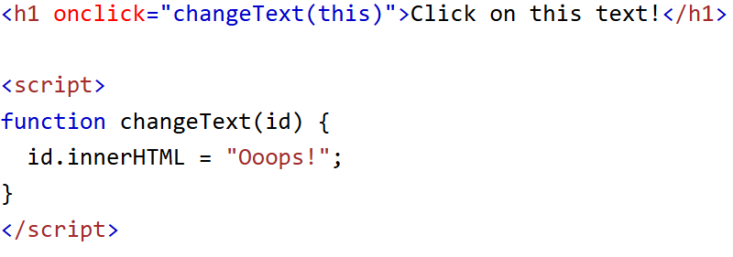
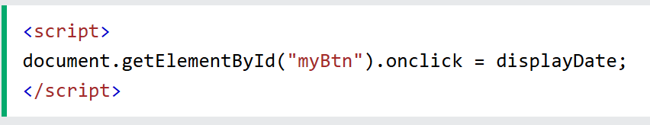

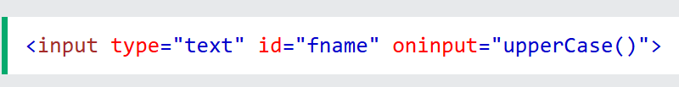
DOM Events
Reacting to Events
Examples of HTML events:
When a user clicks the mouse
When a web page has loaded
When an image has been loaded
When the mouse moves over an element
When an input field is changed
When an HTML form is submitted
When a user strokes a key

Slide 21
DOM EventListener
The addEventListener() method
Attaches an event handler to the specified element
You can add many event handlers to one element.
Add event listeners to any DOM object not only HTML elements.
JavaScript is separated from the HTML markup, for better readability and allows you to add event listeners even when you do not control the HTML markup
Remove an event listener by using the removeEventListener() method

Slide 22
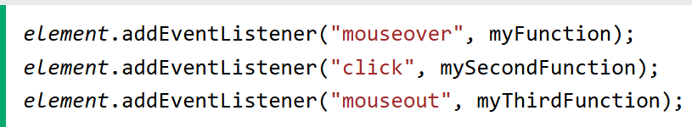
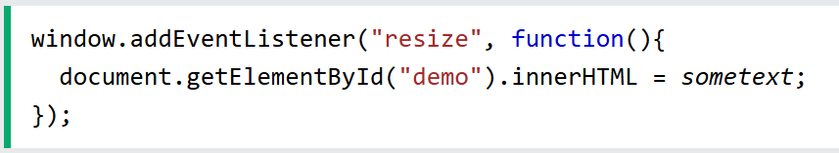
DOM EventListener

Slide 23
DOM Navigation
With the HTML DOM, you can navigate the node tree using node relationships.
You can use the following node properties to navigate between nodes with JavaScript:
parentNode
childNodes[nodenumber]
firstChild
lastChild
nextSibling
previousSibling

Slide 24
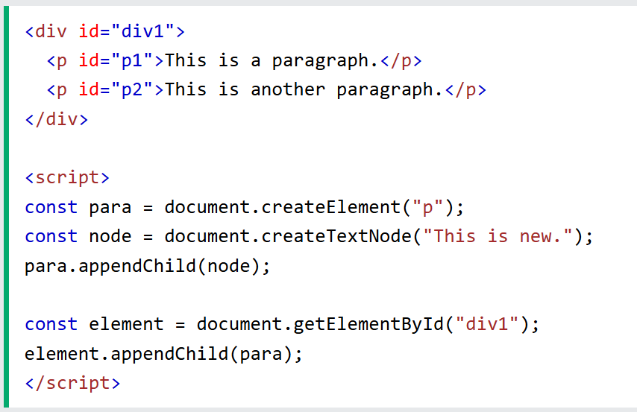
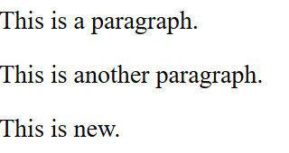
DOM Elements (nodes)
Create New HTML Elements(Nodes)

Slide 25
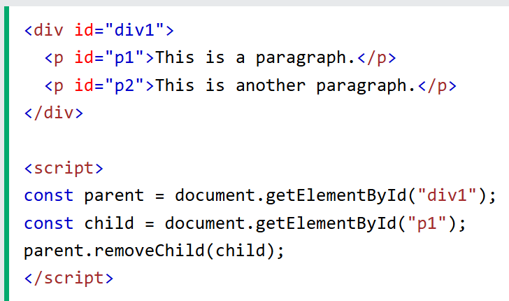
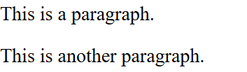
DOM Elements (nodes)
Removing a Child Node

Slide 26
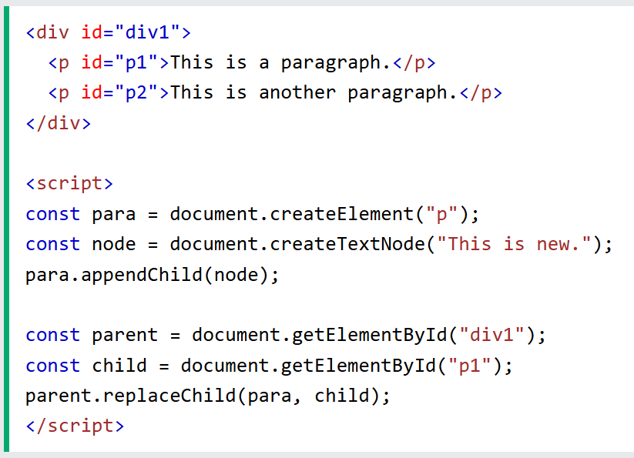
DOM Elements (nodes)
Replacing HTML Elements

Slide 27
DOM Collections
The getElementsByTagName() method returns an HTMLCollection object.
An HTMLCollection is NOT an array!
An HTMLCollection may look like an array, but it is not.
You can loop through the list and refer to the elements with a number (just like an array).
However, you cannot use array methods like valueOf(), pop(), push(), or join() on an HTMLCollection.
The getElementsByClassName() and getElementsByTagName() methods return a live HTMLCollection.

Slide 28

DOM Node List
A NodeList object is a list (collection) of nodes extracted from a document.
A NodeList object is almost the same as an HTMLCollection object.
The querySelectorAll() method returns a static NodeList.
The childNodes property returns a live NodeList.

Slide 29
Home work
Comparing between NodeList and Node Collections

